Slide 1
Indian Stock Market
EDA PROJECT
TEAM 2
Guided by – Mr. Guruprasad Konnurmath

Slide 2
Our Team Details
Batch – A1
Somil Yadav - 133
Shivan Singh - 129
Rajat Singh Jakhar - 123
Prasad Bharatesh Palled - 122

Slide 3
Analysis of the Indian Stock Market
The purpose of this EDA project is to analyze the Indian stock market through historical data. By exploring stock prices, trading volumes, market indices, and sector performances, valuable insights into market behavior and trends can be gained. This analysis aims to identify patterns, correlations, and indicators to assist investors, analysts, and researchers in making informed decisions. Through data visualization, outlier detection, distribution examination, and variable relationship exploration, a deeper understanding of the Indian stock market will be achieved, aiding stakeholders in formulating investment strategies and predicting market movements.

Slide 4
Introduction
Purpose
Conduct EDA on Indian stock market data
Datasets
Data sets contains details of company’s stocks High, Low, Volume, Open, Close, date etc..
Aim
To Visualize datasets and compare them and make predictions to which company it is suitable to invest
1
2
3

Slide 5
Objectives

Slide 6

Objective 1
Understand dataset structure, attributes, and data quality
Gain insights into the dataset's composition, key variables, and identify any missing or erroneous values

Slide 7
Objective 2
Study the distribution of stocks value of the company, identify trends over time, and explore relationships with other variables
Analyze the company’s performance metrics in stock markets.

Slide 8
Objective 3
Predicting Stock market prices ( open, high, low, close )
Predicting the best company to invest stocks

Slide 9
Objectives overview
Understanding data
Data cleaning
Analyzing and visualizing the data
Exploring relation between attributes
Prediction to invest

Slide 10
Dataset overview
Timestamp
Date
Time
Timestamp of Dataset
Date of stock market prices
Time of stock market details
Quarter
Open
Close
Periods of day (morning, afternoon..)
Price at which market opened
Price at which market closed

Slide 11
Dataset overview
High
Low
Volume
Highest stock price of the day
Lowest stock price of the day
The total number of shares traded in a specified time frame
%change
MA
Percent change in close price
Moving Average, it tell average prices of stock

Slide 12
Data Preprocessing

Slide 13
NULL Values
Company: AARTIIND
timestamp 0
date 0
time 0
quater 0
open 692
high 692
low 692
close 692
volume 692
%change 1179
MA 0
dtype: int64
Company: ABCAPITAL
timestamp 0
date 0
time 0
quater 0
open 141
high 141
low 141
close 141
volume 141
%change 153
MA 0
dtype: int64
and so on for 157 more companies…

Slide 14
NULL Values for open, close, high, low
In stock market analysis, It’s not a good way to drop value or replace with mean in stock market for ex. If values like 20 NULL 20, then if mean is 40 it will make data inconsistent.
The best way to replace them is to replace them with previous non NULL values.

Slide 15
NULL Values for volume, %change
Volume: We assuming no one brought the stock for that minute. So we are replacing values with 0.
%change: By definition we can recalculate them by formula given in stock market.
%Change=(curr_close-prev_close)/prev_close*100

Slide 16
Outliers in our Data
In our stock data we know stock market data are inconsistent and every data for each moment data is useful. Even though there is noise or outliers in our data and if we modify it then it will affect in further prediction.

Slide 17
Data Transformation
We used data transformation in our data to convert the time stamp data from data time format to integer data and mapping quarter to [‘0’,’1’,’2’] from [‘early morning', 'late morning’, 'afternoon]

Slide 18
Stock Market Visualization

Slide 19
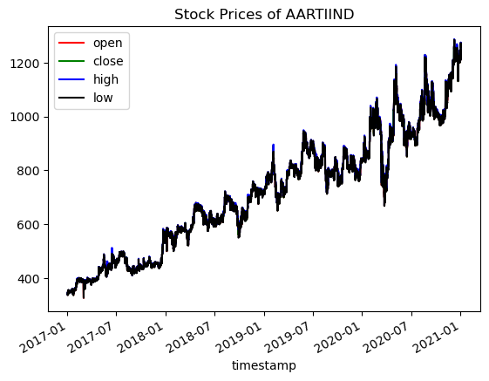
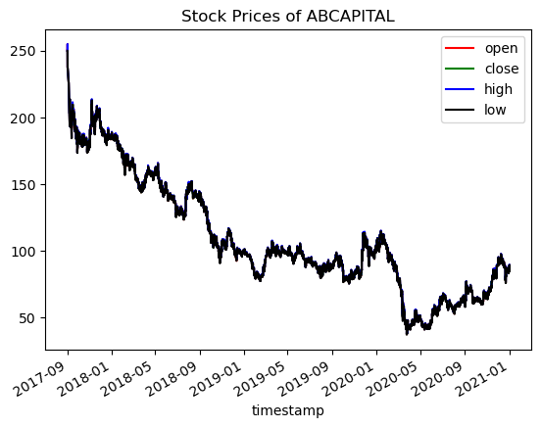
So How does Price change happens according to Date and Time

Slide 20
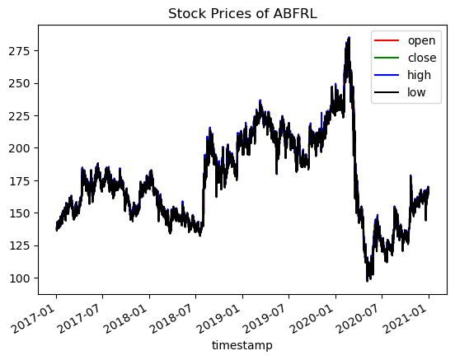
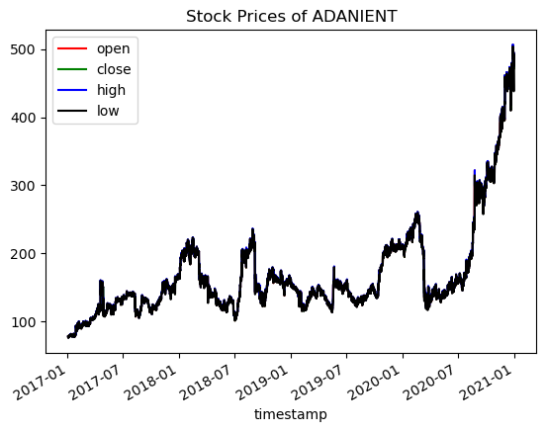
So How does Price change happens according to Date and Time
and so on for 154 more companies…

Slide 21
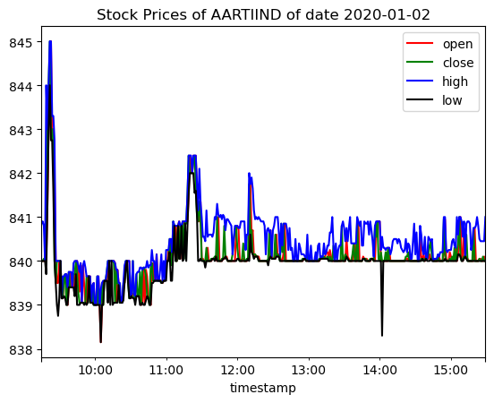
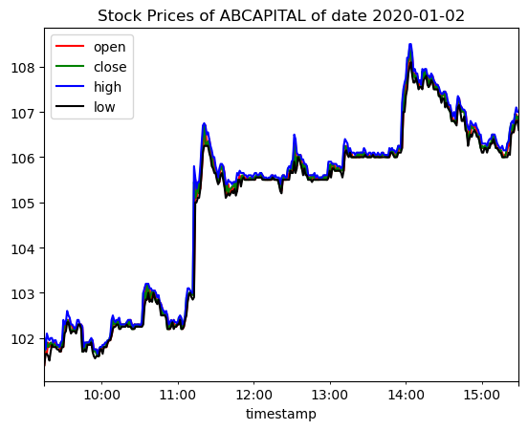
How about changes of price per day?

Slide 22
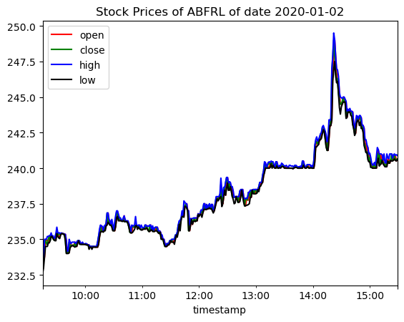
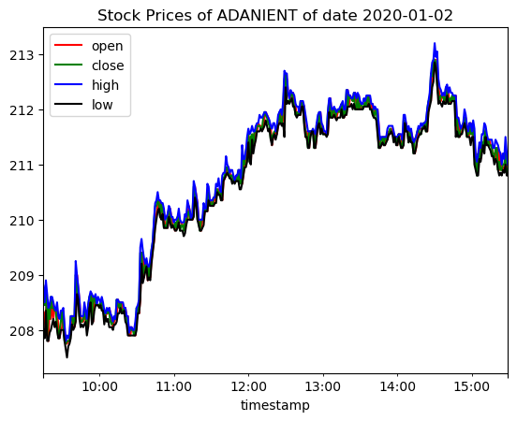
How about changes of price per day?
and so on for 154 more companies…

Slide 23
Stock Market Predictions

Slide 24
Finding best model to predict
As for the average customer, He just want find to stock market prices for particular date that what will be open, close, high, low prices.
So we will predict open, close, high, low values which are float values. So linear regression model from sk learn will be best.

Slide 25
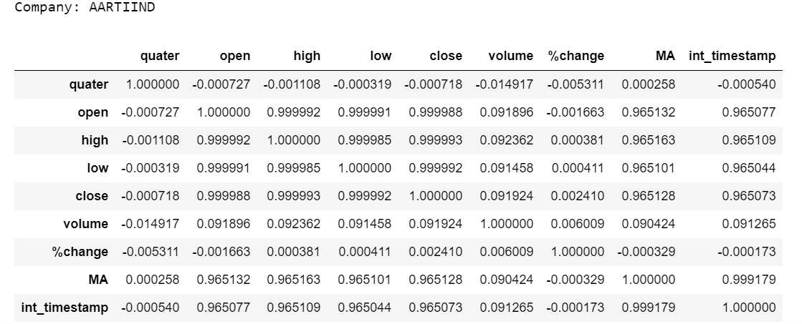
Correlation Between Columns

Slide 26
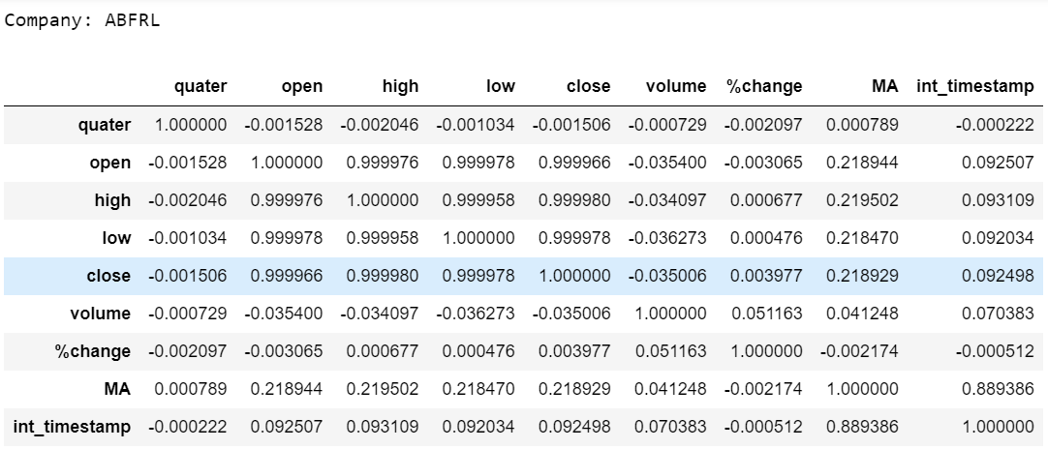
Correlation Between Columns

Slide 27
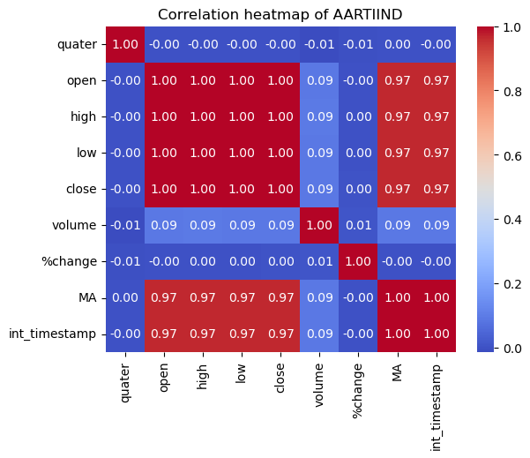
Correlation Between Columns Heatmap

Slide 28
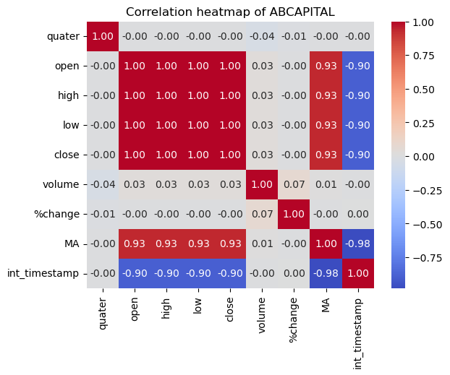
Correlation Between Columns Heatmap

Slide 29
Correlation Between Columns
As only starting with timestamp. We can see correlation between timestamp and MA is high as well as open and MA. So from timestamp first we predicting MA, from from given timestamp and MA we are predicting open
The from Predicted MA, open and given timestamp we are predicting close. And same procedure for high and low

Slide 30
Predictions Mean Square Error
Company GMRINFRA
Mean Square Error for MA: 0.681561275914831
Mean Square Error for open: 6.670817967219985
Mean Square Error for close: 0.0019042509203748925
Mean Square Error for high: 0.0006570024659466621
Mean Square Error for low: 0.0006728098888524553

Slide 31
Predictions for date 21-07-14 15:30:00
COMPANY: GMRINFRA
Predicted Open: [22.22102903]
Predicted High: [22.25326726]
Predicted Low: [22.19410753]
Predicted Close: [22.22102357]

Slide 32
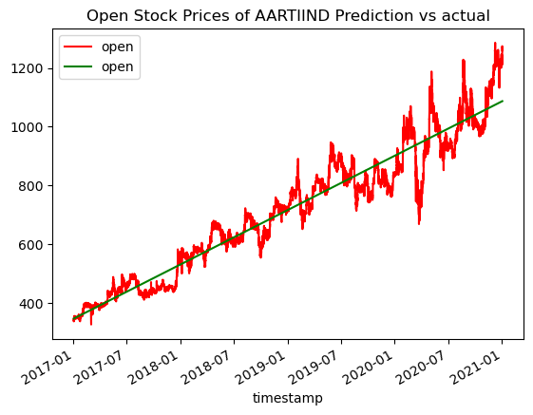
Predictions VS Actual Data

Slide 33

Predictions VS Actual Data

Slide 34

Predictions VS Actual Data

Slide 35

Predictions VS Actual Data

Slide 36
Best Company to put stock for a date and time
Company We should invest on date 2021-01-02 and time 15:30:00 is SRF with profit of 0.02635884097253438

Slide 37
Best Company to put stock for a date
Company We should invest on date 2023-07-20 is NESTLEIND with profit of 2.097678437919967

Slide 38
Key Findings
•The dataset contains information about stock market of different Indian companies like timestamp, date, time, open, high, low.
•Missing values were handled for numerical features like open, high, low, close columns by replacing it with previous non null values. For Volume it is replaced by 0 and %change is recalculated.
•Timestamp is transformed in integer and Quarter is mapped to integer
•Visualizations were created to show open, high, low, close, moving average
•A correlation heatmap was used to show the relationships between numerical features. It helped identify any significant correlations between attributes.
•A linear regression model was trained to predict open, close, high, close value. The model's accuracy on the validation set was calculated to evaluate its performance.
•The Graph of open, high, low, close are almost identical this means they are highly correlated
•The Moving Average Shows slope on Company stock market whether rising and or falling

Slide 39
Thank you

